Slide 1

Hotel Booking Demand Dataset Analysis
Predicting Cancellation
Purwadhika Final Project JCDSOL-13 (Kelompok Gamma)

Slide 2
Business Problem Understanding
Hotel cancellation rate as much as 40% has a negative impact
on hotel revenue and operational schedule
Efficient management of hotel reservations is necessary to optimize revenue.
A study conducted by D-Edge Hospitality Solutions found that the cancellation rate across various booking channels in Europe reached almost 40% in 2018*. This could impact negatively on hotel revenue.
Booking cancellation can cause potential revenue loss, underutilization of hotel assets, and operational schedule disruption
It is necessary to develop a solution that could predict booking cancellations in advance to minimize potential loss and disruptions.
*https://www.d-edge.com/how-online-hotel-distribution-is-changing-in-europe/

Slide 3
Goals
The goals are to predict and prevent booking cancellations with proactive measures
Develop a model that could accurately predict booking cancellations before they occur.
Help implementing proactive measures to the particular booking such as dynamic pricing or discount offers to discourage cancellation or mitigate potential revenue loss.

Slide 4
Analytical Approach
The Workflow for Model Development, from Data Understanding to Conclusion
Data Understanding
Data Cleaning
Data Analysis
Model Preparation
Modelling
Model Selection & Optimization
Conclusion & Recommendation

Slide 5
Evaluation Metric
Minimizing False Negatives to Protect Revenue by Prioritizing Recall as the Key Metric
The evaluation metrics for the classification models are as follows :
(Positive = Flagged as potentially canceled booking)
Precision
The ratio of correctly predicted cancellations to all predicted cancellations (true positives / (true positives + false positives)).
High precision means that when a booking is predicted to be a cancellation, it is likely correct. This is important to avoid unnecessary actions on bookings that will not cancel.
Recall
The ratio of correctly predicted cancellations to all actual cancellations (true positives / (true positives + false negatives)).
High recall means fewer actual cancellations are missed. This is important if the business wants to ensure that most potential cancellations are identified.
* F1-score
The harmonic mean of precision and recall (2 * (precision * recall) / (precision + recall)).
F1-score is used when a balance between catching most cancellations (recall) and ensuring that flagged cancellations are mostly correct (precision) are required. This important if both missing cancellations and misclassifying non-cancellations have comparable business costs.

Slide 6
Evaluation Metric
Minimizing False Negatives to Protect Revenue by Prioritizing Recall as the Key Metric
In this case, if the proactive measure to prevent potential cancellations is to offer discounted pricing (for example, 30%) to discourage cancellations, the effects are as follows:
False Negatives: Loss of 100% of the potential revenue due to the loss of a customer who cancels but was not predicted to cancel.
False Positives: Loss of 30% of the potential maximum revenue because a discount was offered to a customer who would not have canceled and would have paid full price.
Therefore, it is more important to minimize false negatives because their potential loss is higher. As such, the primary evaluation metric for this project will be recall.

Slide 7
Data Source
Dataset Sourced from Algarve Resort and Lisbon City Hotels (2015–2017) by Antonio, Almeida, and Nunes
The data is originally from the article *Hotel Booking Demand Datasets*, written by Nuno Antonio, Ana Almeida, and Luis Nunes for Data in Brief, Volume 22, February 2019.
This data article describes two datasets with hotel demand data. One of the hotels (H1) is a resort hotel and the other is a city hotel (H2). Both datasets share the same structure, with 31 variables describing the 40,060 observations of H1 and 79,330 observations of H2. Both hotels are located in Portugal: H1 at the resort region of Algarve and H2 at the city of Lisbon. Both datasets comprehend bookings due to arrive between the 1st of July of 2015 and the 31st of August 2017, including bookings that effectively arrived and bookings that were canceled.

Slide 8
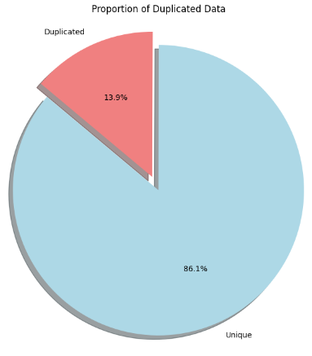
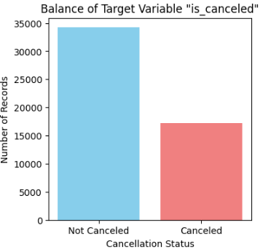
Data Analysis
The dataset contains 14% duplicate entries and an imbalanced target variable
The dataset has 14% duplicate data that needs to be deleted, and the target variable is imbalanced, which can cause bias during model training.
To reduce bias during model training, resampling can be used to balance the data..

Slide 9
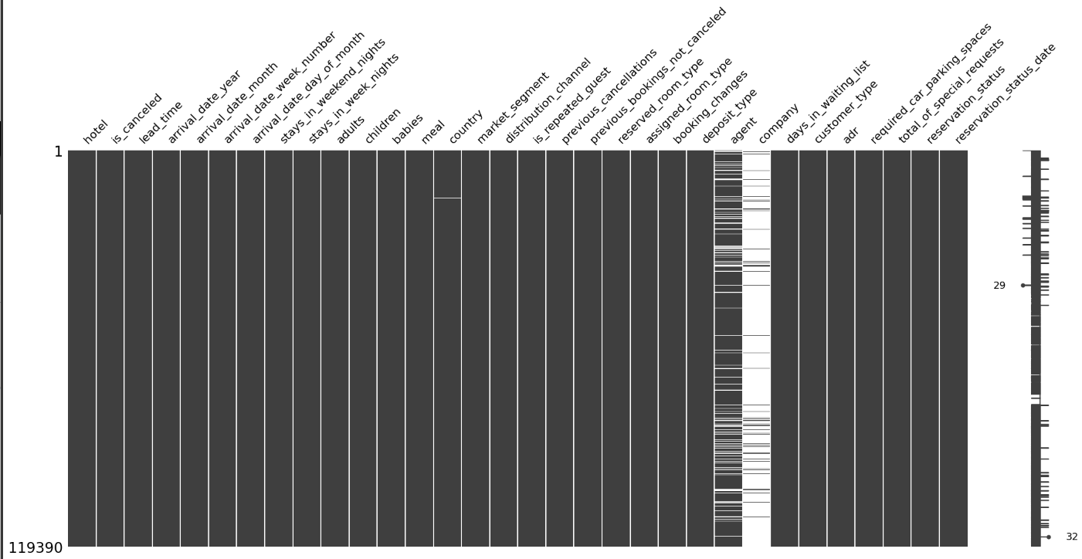
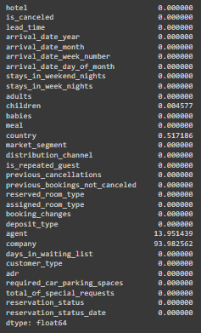
Data Analysis
Handling Missing Values by Deleting “Company” and Imputing Other Columns
Column with missing values is children, country, agent, and company.
Dataset have many missing values, ‘Company’ column have 92% missing values
Company have too many missing data so we should just delete the column itself, because even if we impute Company with mode the data will have 92% values filled by that mode, which can cause bias and will neglect the integrity of data.
While others column that have no significant percentage of missing values can be imputed with median, mode, or mean.

Slide 10
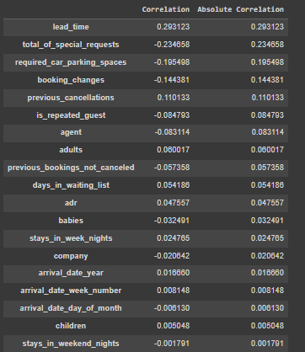
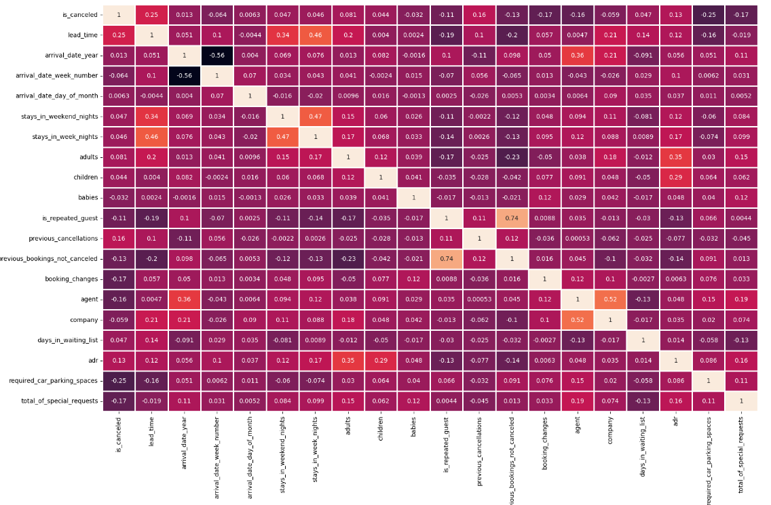
Data Analysis
The Most and Least Correlated with Target Variable Identified Using Point Biserial Correlation
Using Point Biserial correlation, the columns with the most and least impact on the target variable are identified.
Lead_time, total_of_special_requests, and required_car_parking_spaces are the most correlated with the target variable.
Stays_in_weekend_nights, children, and arrival_date_day_of_month have the least correlation with the target variable.

Slide 11
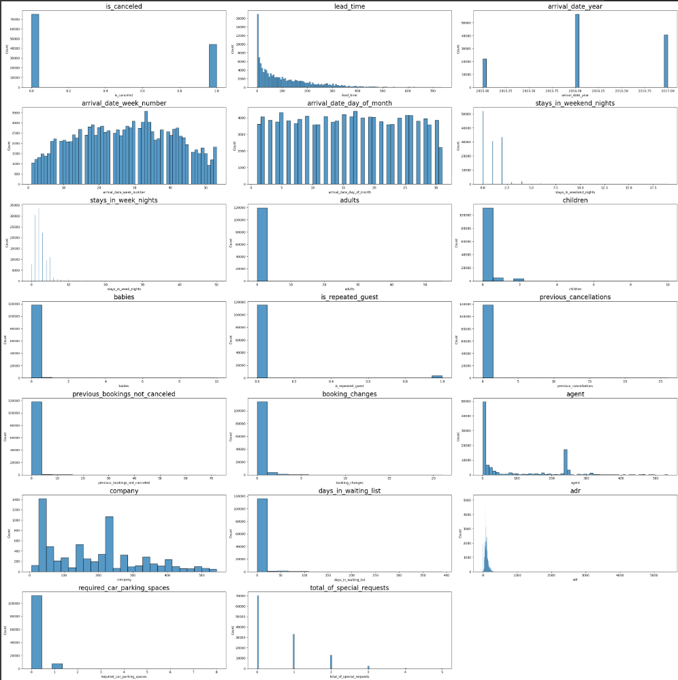
Data Analysis
The distribution of numerical features is mostly skewed and not normal.
Because the data distribution is skewed, the median value is used as the central tendency measure for filling in missing values and managing outliers.

Slide 12
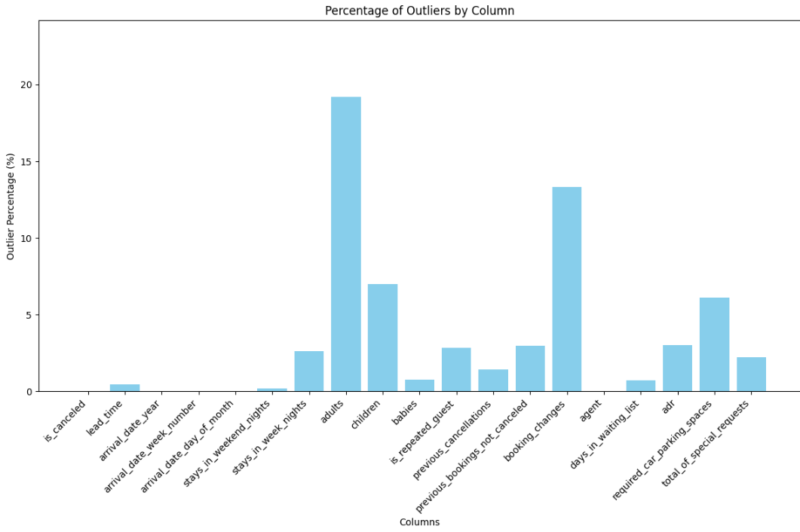
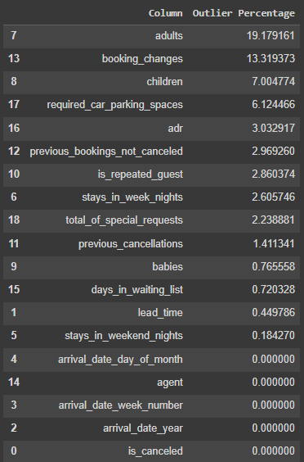
Data Analysis
Numerical Features Have Many Outliers, particularly in adults, booking_changes, and children
Adults, booking_changes, children have the most outliers in the dataset.
These can be replaced with the median or kept, but keeping them might risk overfitting.

Slide 13
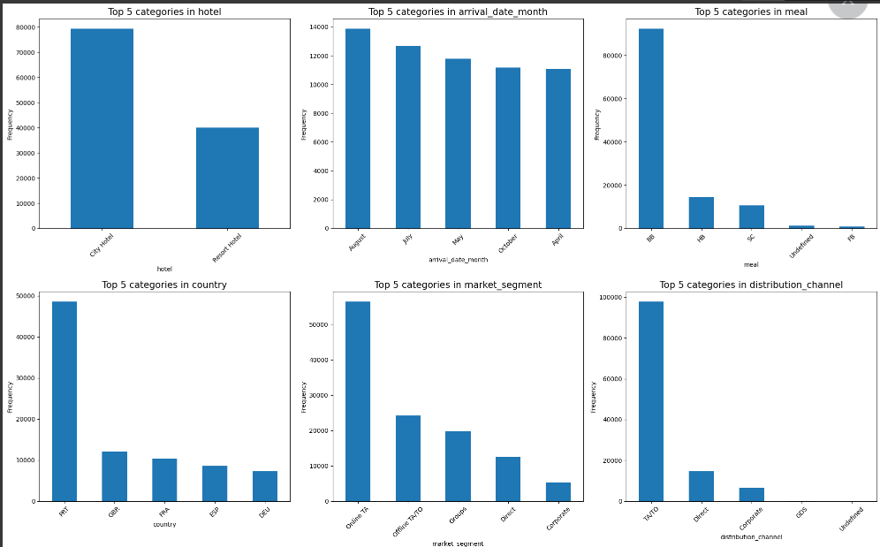
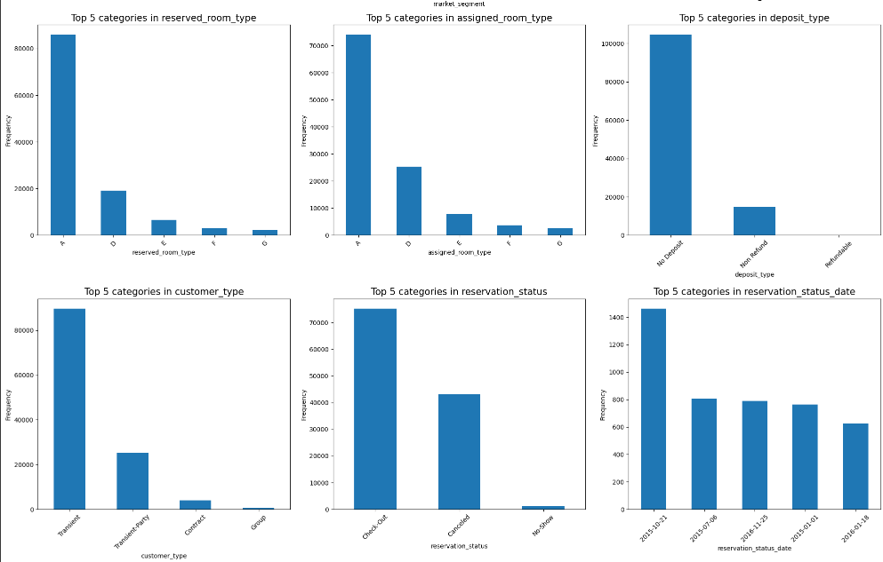
Data Analysis
Most categorical features have a single dominant value that significantly exceeds the others
In most columns, one value is clearly the most frequent, except for hotel, arrival_date, reservation_status, and reservation_status_date.
The country column is mainly PRT (Portugal), market_segment is mostly Online TA, distribution_channel is primarily TA/TO, customer_type is mainly Transient, deposit_type is mostly No Deposit, reserved_room type is mainly A, and meal type is mostly BB.

Slide 14
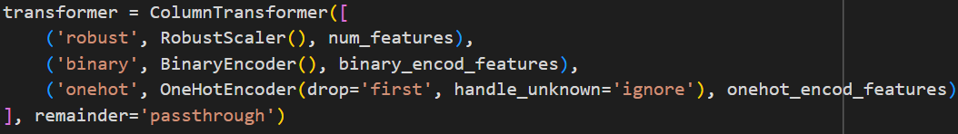
Modelling & Evaluation - Encoding
Data Preprocessing involves separating features, splitting data, and encoding
Separate numerical and categorical features
Splitting training data and testing data
Preprocessing with ColumnTransformer
Use RobustScaler for numerical features
Use BinaryEncoder and OneHotEncoder for categorical features (based on the number of unique values)

Slide 15
Modelling & Evaluation - Modelling
Multiple Classification Models Evaluated with Cross-Validation
LogisticRegression
KNeighborsClassifier
DecisionTreeClassifier
RandomForestClassifier
XGBClassifier
LGBMClassifier
Rule-based Function as Benchmark
Uses StratifiedKFold for cross-validation

Slide 16
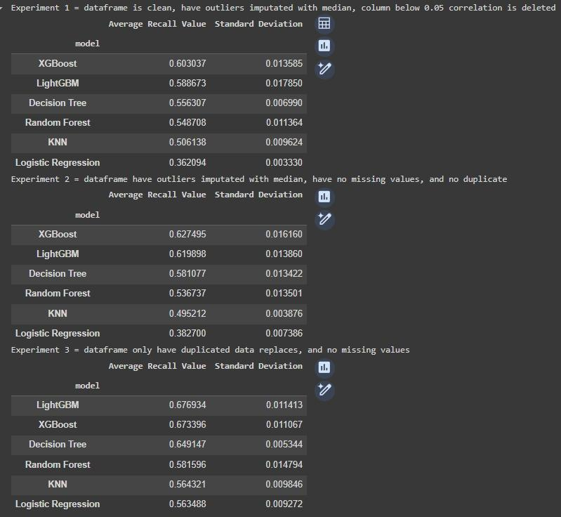
Modelling & Evaluation - Experiments
Experiments with outliers and low-correlation features shows that the unmodified clean dataset provides the best results overall, while XGBClassifier achieves the highest recall overall
Experiment 1
Clean dataset with outliers imputed using the median and columns with a correlation below 0.05 removed

Slide 17
Modelling & Evaluation - Experiments
Experiments with outliers and low-correlation features shows that the unmodified clean dataset provides the best results overall, while XGBClassifier achieves the highest recall overall
Experiment 2
Clean dataset with only the outliers imputed using the median

Slide 18
Modelling & Evaluation - Experiments
Experiments with outliers and low-correlation features shows that the unmodified clean dataset provides the best results overall, while XGBClassifier achieves the highest recall overall
Experiment 3
Clean dataset only, with outliers and low correlation columns have not been modified..

Slide 19
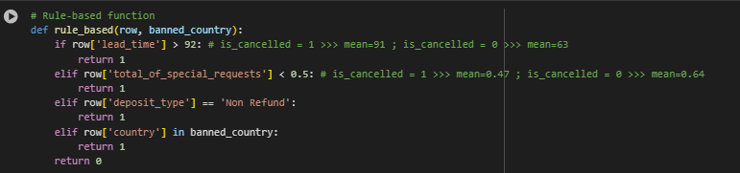
Modelling & Evaluation - Experiments
Experiments with outliers and low-correlation features shows that the unmodified clean dataset provides the best results overall, while XGBClassifier achieves the highest recall overall
Rule Based
Here we try using Rule Based, we achieved 0.56 Recall which is not ideal to predict our data and we better off using our Machine Learning models to predict

Slide 20
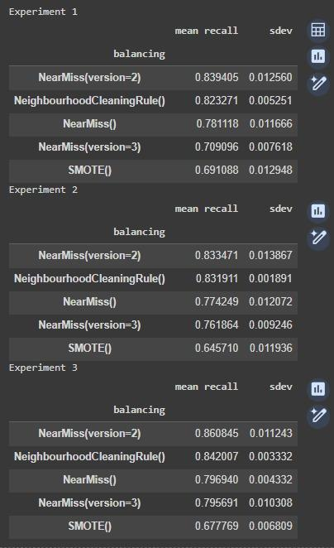
Modelling & Evaluation –Resampling
Experiments with balancing show that NearMiss-2 has the best recall overall
Using the same variables as previous experiments, it is found that NearMiss-2 produces the highest average recall score compared to other balancing method.

Slide 21
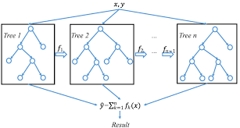
Modelling & Evaluation
Explanation on how XGBoost works, from initialization to iteration.
XGBoost (Extreme Gradient Boosting) is a powerful and efficient implementation of the gradient boosting framework, designed for speed and performance.
Key Steps in XGBoost Training
Initialization: Start with an initial prediction, typically the mean of the target variable.
Calculate Residuals: Compute the difference between the predicted and actual values (residuals).
Fit a New Tree: Train a new decision tree on the residuals to correct the errors of the previous model.
Update Predictions: Add the new tree's predictions to the previous predictions, scaled by the learning rate.
Iterate: Repeat steps 2-4 for a specified number of iterations or until the model converges.

Slide 22
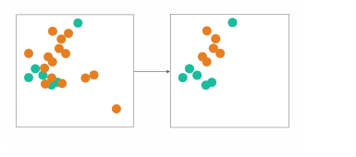
Modelling & Evaluation
Explanation on how NearMiss balances datasets by under-sampling, with NearMiss-2 focusing on removing the farthest points.
The NearMiss resampler is a technique used in imbalanced datasets to balance the class distribution by under-sampling the majority class. It is part of the family of resampling methods aimed at improving the performance of classifiers when dealing with imbalanced data, where one class significantly outnumbers the other(s).
Nearmiss-2 will work similar to Nearmiss-1. Nearmiss-2 algorithm works by , instead of looking of K-Nearest points, it will look at the K-farthest points and rank them in the farthest first order. Based on the sampling ratio provided it will remove the first n points from the majority class. This is more helpful in removing outliers and re sampled data is more concentrated in the center.

Slide 23
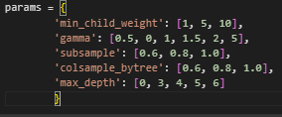
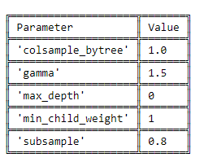
Modelling & Evaluation – Hyperparameter Tuning
Hyperparameter Tuning leads to a slight improvement in the recall score
Hyperparameter values that gridSearch uses is :
The best hyperparameter value for our model is :
Recall Score before hyperparameter tuning: 0.8676888919725249
Recall Score after hyperparameter tuning: 0.8710886005689308

Slide 24
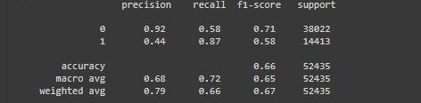
Modelling & Evaluation – Hyperparameter Tuning
Hyperparameter Tuning leads to a slight improvement in the recall score
Final score for the ML model after hyperparameter tuning process :

Slide 25
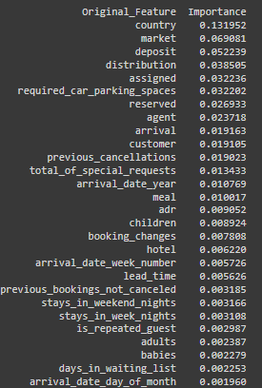
Modelling & Evaluation – Feature Importance
Feature importance analysis reveals that country, market_segment and deposit_type are the most important features
The graph shows that the most important features include country, market_segment, and deposit_type
This could be beneficial for reducing future cancellation, for example, the company can adjust their services/ strategies on specific cultural preferences/expectations, or implementing flexible deposit policies to reduce cancellation

Slide 26
Conclusion & Recommendation
Machine Learning Significantly Increases Revenue Compared to No Prediction
Calculating revenue differences using Machine Learning
Scenario 1: Without Machine Learning Prediction
1. Total Bookings (B) = 1000
2. Cancellation Rate (CR): 40% (0.4)
3. Average Room Rate (ARR): $100
Cancellations :
- Cancellations = B x CR = 1000 x 0.4 = 400
Revenue without Machine Learning:
- Revenue without Machine Learning = (B - Cancellations) x ARR
- (1000 - 400) x 100 = 600 x 100 = $60.000

Slide 27
Conclusion & Recommendation
Machine Learning Significantly Increases Revenue Compared to No Prediction
Scenario 2: With Machine Learning Prediction
1. Total Bookings (B): 1000
2. Cancellation Rate (CR): 40% (0.4)
3. Average Room Rate (ARR): $100
4. Recall (R): 87% (0.87)
5. Precision (P): 44% (0.44)
6. Discount Rate (D): 30% (0.3)
Confusion Matrix :
True Positives (TP): 348
False Negatives (FN): 52
False Positives (FP): 443
True Negatives (TN): 157
Revenue from True Negative (Full Price/Non Discounted Booking) :
TN x ARR : 157 x $100 = $15700
Revenue from True Positive
(Discounted Price, Predicted Cancellation/Retained Booking) :
TP x ARR x (1-D) 348 x $100 x $70% = $24360
Revenue from False Positive (Discounted Price, Falsely Predicted Non-Cancellation) :
FP x ARR x (1-D) 443 x $100 x $70% = $30010
Revenue from False Negative (Total Loss, Falsely Predicted Actual Cancellation)
FN x 0 = 0$
Total Revenue = $15700 + $24360 + $30010 + $0
= $70070

Slide 28
Conclusion & Recommendation
Machine Learning Significantly Increases Revenue Compared to No Prediction
Comparison
- Revenue without Machine Learning: $60000
- Revenue with Machine Learning: $70070
Net Benefit of Machine Learning
- Net Benefit = Revenue With Machine Learning - Revenue without Machine Learning
- 70.070- 60000 = $10070
In our case, using our machine learning prediction to correctly offer a 30% discount to predicted cancellations results in a net benefit of $10070 or 16.78%, demonstrating a significant improvement in revenue compared to not using machine learning.

Slide 29
Conclusion & Recommendation
It is recommended to regularly retrain the model, check data quality, and update features to maintain accuracy
Establish a schedule for periodically retraining the cancellation prediction model on fresh data to capture evolving patterns and trends in booking cancellations.
Perform periodic checks to ensure the quality of future input data sources. Address any inconsistencies, missing values, or data anomalies to maintain the reliability of the model's predictions.
Continuously assess the relevance and effectiveness of input features. Introduce new features or remove irrelevant ones based on current conditions and insights from data analysis.

Slide 30
Conclusion & Recommendation
The model has limitations in handling time-based patterns, potentially missing important features, and only performs well on data similar to its training set
The model treats all time periods equally. However, cancellation patterns may vary seasonally, during holidays, or in response to external events. This could result in inaccurate predictions during peak cancellation periods or during certain emerging trends and patterns over time. Incorporating time-dependent features or time series analysis techniques could enhance the model's predictive accuracy.
The current model may be based on a limited set of input features, potentially not including important predictors of booking cancellations. Features such as customer preferences, booking history, or external factors like economic conditions or travel restrictions may not be recorded. This could lead to poor performance and incomplete understanding of reasons for booking cancellation.
The current model also have limitation to only be able to predict with good performance if the test data is already within the range of the trained dataset.

Slide 31
Thank You
PURWADHIKA FINAL PROJECT JCDSOL-13

